Slide 1
Servlet
Java Serverside programming Technology

Slide 2
Objectives
About ServletConfig and ServletContext
About HttpServletRequest and HttpServletResponse.
Form data Processing by Servlet.

Slide 3
About ServletConfig
A ServletConfig contains servlet configuration information like servlet name and deployment time parameters.
Using ServletConfig we can access servlet init parameters configured in Deployment Descriptor (web.xml).
It can also give you a ServletContext.
For each servlet, container creates one ServletConfig .
One ServletConfig object per servlet.
Each Servlet and JSP in the web application has its own ServletConfig.

Slide 4
ServletConfig Methods
ServletContext getServletContext();
String getInitParameter(“parameter name”);
Enumeration getInitParameterName();
String getServletName();

Slide 5
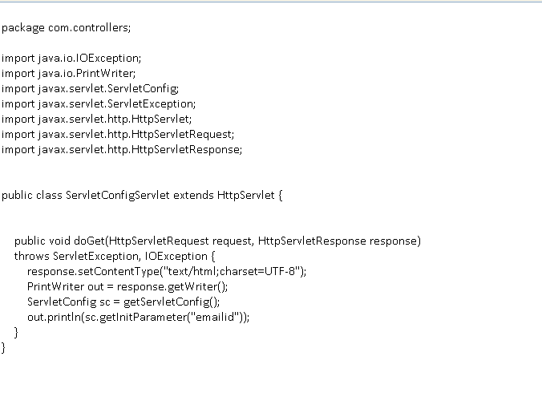
Source code of ServletConfigServlet.java
Retrieving initialization parameter from servletconfig

Slide 6
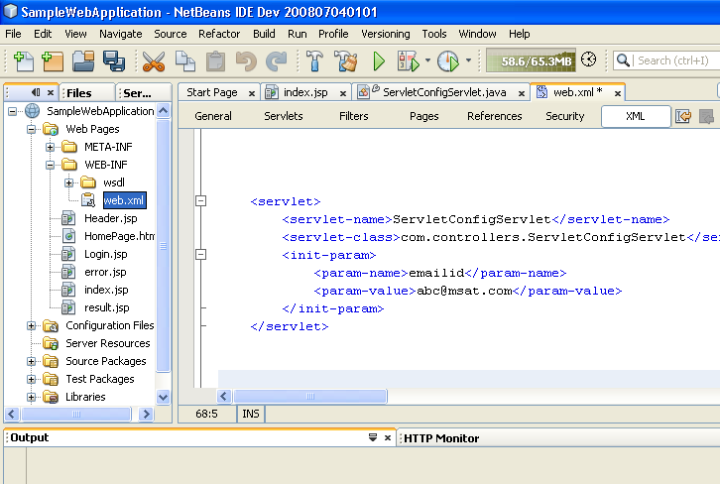
View of web.xml
After creating ServletConfigServlet by passing init parameters, configuration of Servlet looks like below in web.xml file.

Slide 7
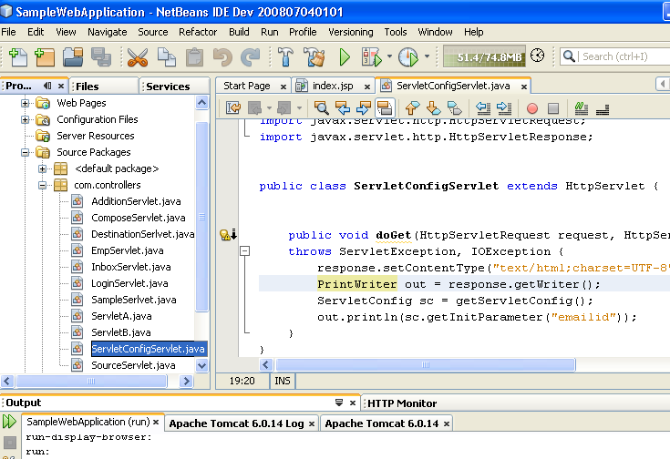
Run ServletConfigServlet
Run the ServletConfigServlet by pressing Shift+F6.

Slide 8
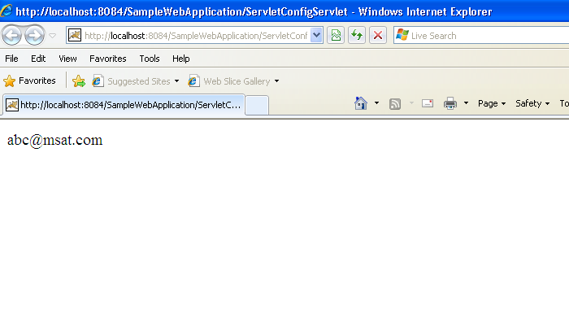
ServletConfigServlet Output
Emailid initialization parameter value

Slide 9
When to use ServletConfig init parametes
When we want to display an email address using a servlet.
Don’t hardcode it insde servlet class.
Hard coding the email address inside servlet class is BAD!
PrintWriter out = response.getWriter();
out.println(“abc@msat.com”);
If we hard code email id inside servlet ,we need to recompile the servlet if the email id changes.
So, Don’t hard code email id inside servlet.
Configure email id as servlet initialization parameter in Deployment Descriptor( web.xml).
If the email id changes, just modify the initialization parameters in web.xml and redeploy.

Slide 10
About ServletContext
There is only one ServletContext for an entire web application.
All the parts of the web application share it.
The container makes a ServletContext when a web application is deployed.
Container makes ServletContext available to each Servlet and JSP in the web application.
Use it to get server info, including name and version of the container, and the version of the API that is supported.
Use it to access web application parameters( initialization parameters for web application).
Use it as a kind of application bulletin-board, where you can put up message ( called attributes) that other parts of the application can access.

Slide 11
ServletContext Methods
String getInitParameter(“context parameter name”);
Enumeration getInitParameterNames();
Object getAttribute(“ attribute name”);
void setAttribute(“attribute name”, attribute object);
void removeAttribute(“attribute name”);
int getMajorVersion();
int getMinorVersion()’
String getServerInfo();
RequestDispatcher getRequestDispatcher(“resource name”);

Slide 12
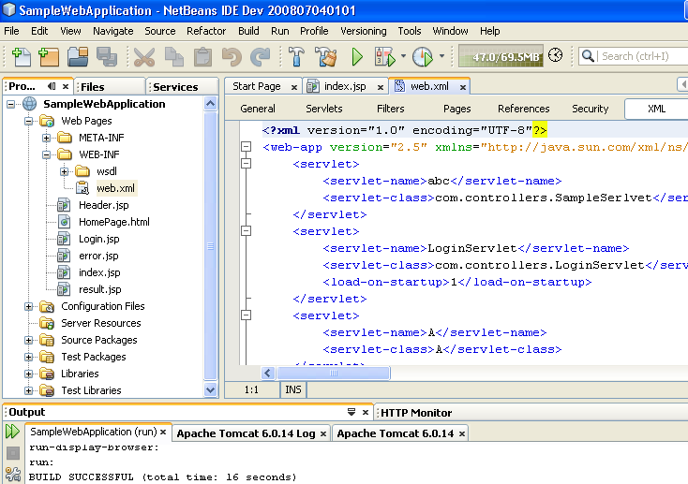
Demonstration of setting and retrieving context init parameters
Step 1:
Open Deployment Descriptor file ( web.xml ).

Slide 13
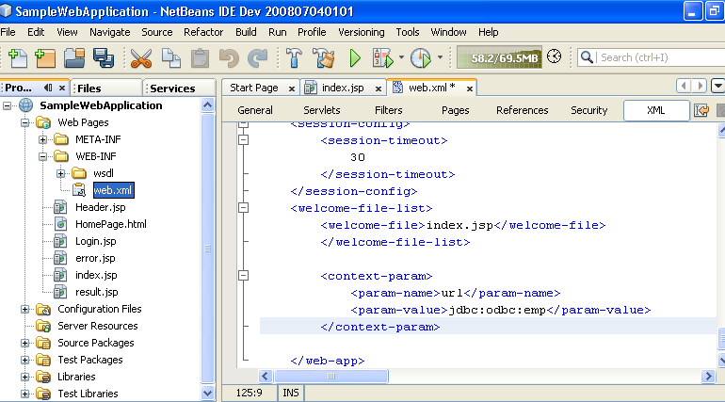
Demonstration of setting and retrieving context init parameters
Step 2:
Provide context parameter details in web.xml file.
Context parameter details

Slide 14
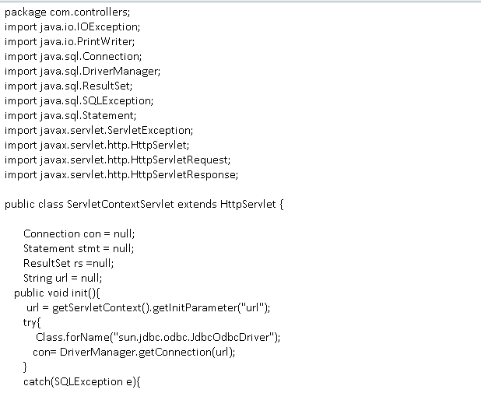
Demonstration of setting and retrieving context init parameters
Step 3:
Create a new Servlet (ServletContextServlet.java).
Retrieving context init parameters using ServletContext

Slide 15
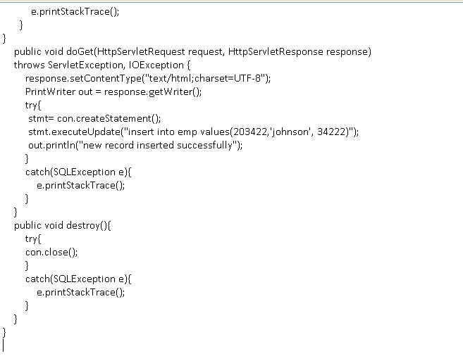
Demonstration of setting and retrieving context init parameters

Slide 16
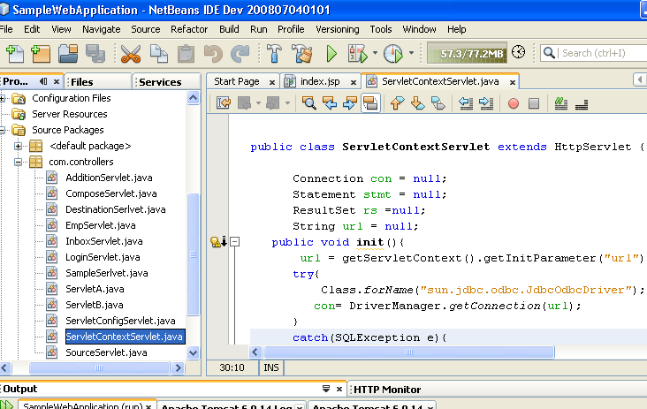
Demonstration of setting and retrieving context init parameters
Step 4:
Run the ServletContextServlet.java by pressing Shift+F6.

Slide 17
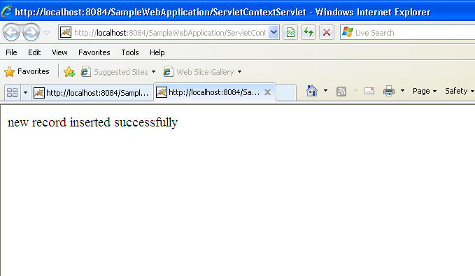
Output

Slide 18
When to use context init parameters
Let us assume a scenario where one web application consists of many servlets and all the servlets trying to establish a database connection and perform transactions.
Don’t hardcode database url connection string inside servlets.
Hardcoding database connection url string inside servlets is BAD!
Class.forName("sun.jdbc.odbc.JdbcOdbcDriver");
con= DriverManager.getConnection(“jdbc:odbc:emp”);
If database connection url configured as context init parameter in web.xml, if database connection url changes, just we need to modify in web.xml context parameter details and redeploy. No need of changing inside each and every servlets and recompile.

Slide 19
WebApplication
ServletContext
Servlet B
Index.jsp
Servlet A
ServletConfig
ServletConfig
ServletConfig

Slide 20
About HttpServletRequest
HttpServletRequest interface extends ServeltRequest interface.
Container creates Request object when the client makes a new request.
Client information and data is wrapped in request object.
We can trace the client details like IP details.
We can retrieve the data sent by the client
Container destroys request object after the response is sent to the client.
We can share the information between two servlets or jsp using request object by setting attributes in request object.

Slide 21
HttpServletRequest Methods
Object getAttribute(“attribute name”);
void setAttribute(“attribute name”, attribute object);
RequestDispatcher getRequestDispatcher(“resource url”);
String getRemoteAddr();
String getParameter(“parameter name”);
Enumeration getParameterNames();
String[] getParameterValues();
Cookie[] getCookies();
String getHeader(“header name”);
HttpSession getSession();
String getMethod();

Slide 22
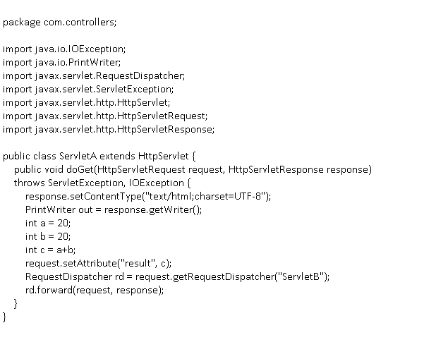
Demonstration of HttpServletRequest
ServletA.java
ServletA wants to share result with ServeltB

Slide 23
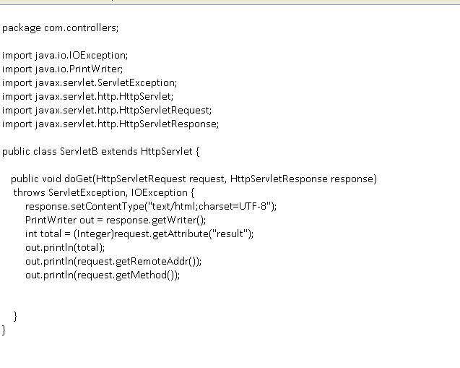
Demonstration of HttpServletRequest
ServletB.java
Retrieving attribute shared by ServletA
Retrieving client IP

Slide 24
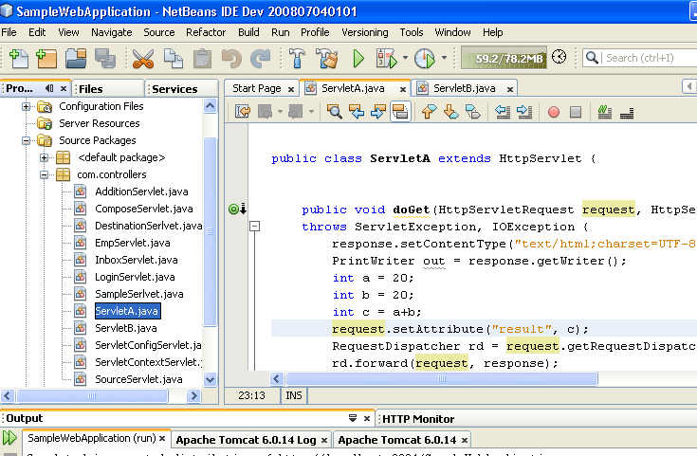
Run the Program
Run the ServletA.java by pressing Shift+F6

Slide 25
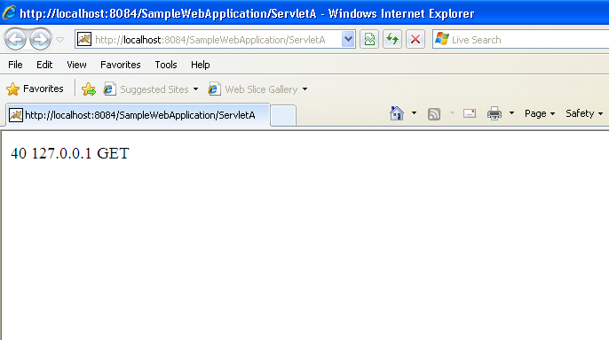
Output
HTTP method
Result value displayed by ServletB which was shared by ServletA
Client IP

Slide 26
About HttpServletResponse
HttpServletResponse interface extends ServletResponse interface.
Container creates a new response object when every time the client makes a new request.
Container destroys response object when the response is sent to the client.
We use response object to get an output stream ( usually Writer) and we use that stream to write the HTML or other type of content that goes back to the client.
The response is what goes back to the client.
Client browser gets the response, parses and renders for the user.
Using response we can send cookies to the client browser.
We can also set headers.

Slide 27
HttpServletResponse Methods
void setContentType(“MIME type” );
int getBufferSize();
ServletOutputStream getOutputStream();
PrintWriter getWriter();
void addCookie();
void addHeader();
void addIntHeader();
void setHeader();
void setIntHeader();
void sendRedirect()

Slide 28
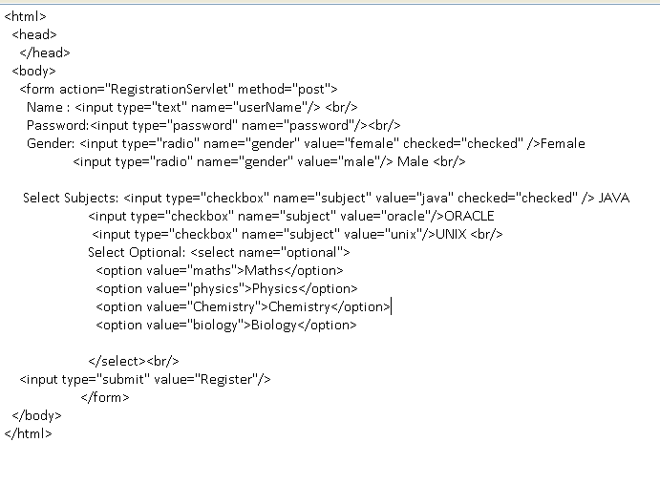
Form Data Processing by Servlet
RegistrationForm.html

Slide 29
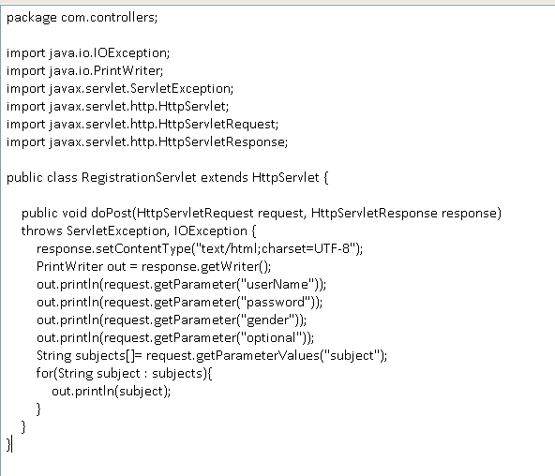
Form Data Processing by Servlet
RegistrationServlet.java

Slide 30
Thank you

